Slide 1
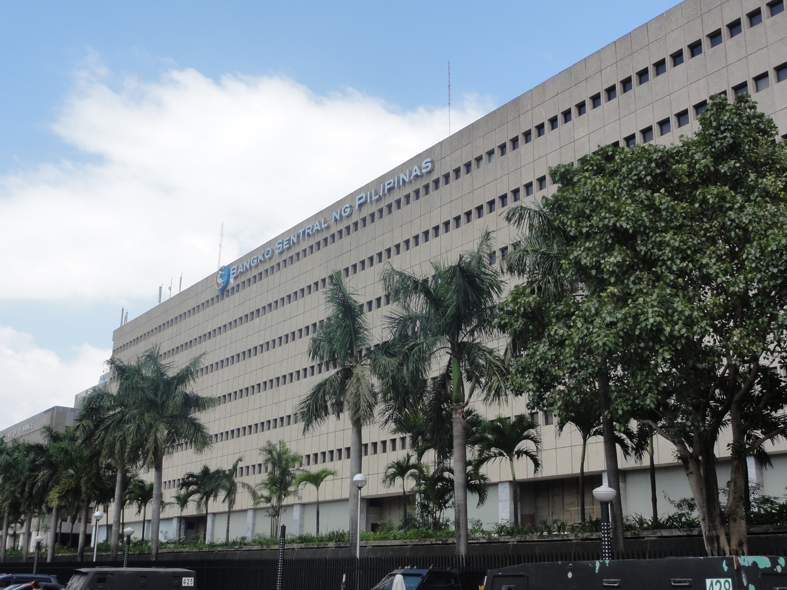
In Banks We Trust
Predicting the Propensity to Avail
Formal Financial Services in the Philippines
AIM MSDS 2020 Machine Learning Project
Reyes, Rivero, Salvano, Srivastava

Slide 2


Did you know?
9
Out of 10
Filipino
Households
Remain Unbanked
Source: 2014 Consumer Finance Survey (Bangko Sentral ng Piilipinas)
Notes:
86% of households in the Philippines do not have even one member that has a deposit account, that’s according to the 2014 Consumer Finance Survey of the Bangko Sentral ng Pilipinas which surveyed 15,503 households across the country.
93% of these households said they remain unbanked because they just don’t have the extra money.
But what if hypothetically speaking they do have some to spare?
35.7% of them said they would want to save it in a bank or other financial institutions, while 36% of them would keep it in their piggy banks at home.

Slide 3

Opportunity:::: Growing Customer Base for the Banking System
6.2%
GDP growth
forecast for 2019
Upper-Middle Income Economy
by year 2020

Slide 4



Deposit in banks
Where will you put
your money>?
((((If you have surplus)
or
Keep
at home
50.4%
49.6%
Source: 2014 Consumer Finance Survey for Households without Deposit Accounts due to Lack of Funds (BSP)

Slide 5
What Influences
Your Preference?
or
Deposit
in banks
Keep
at home

Slide 6
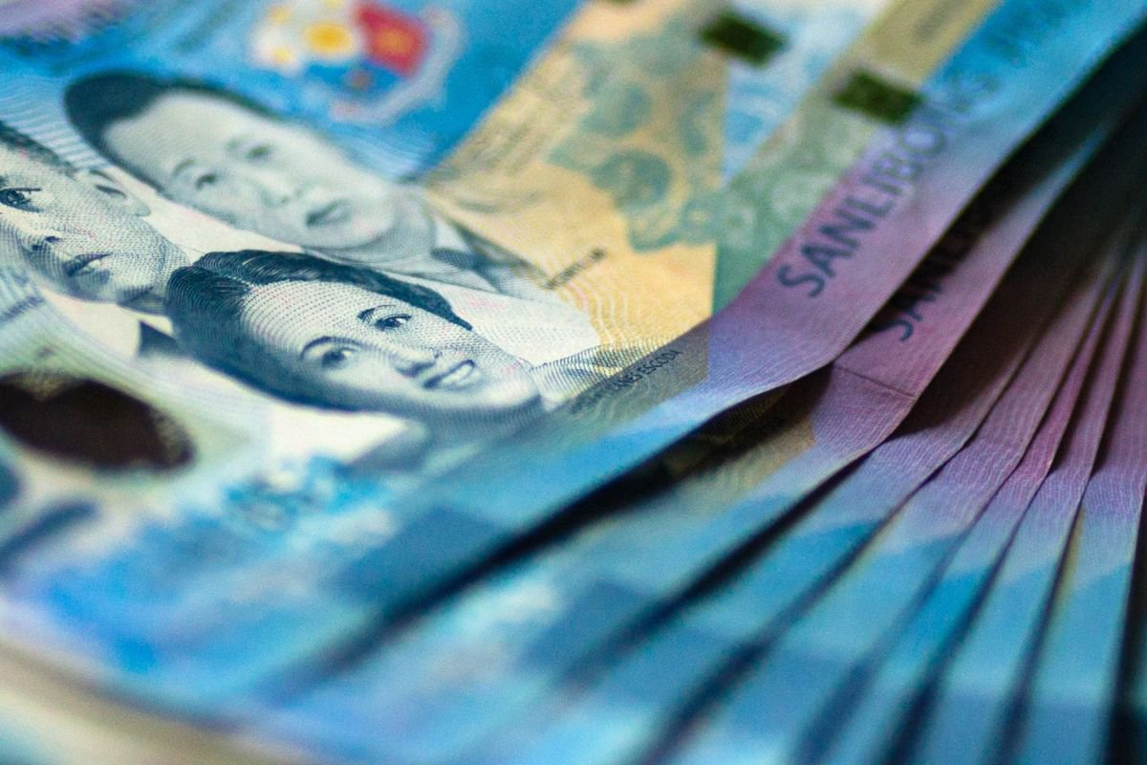

Model Training
On 6,600 Households
Features
Demographics
Financial Attitude
Machine Learning
Prediction Model
Preference
Bank or Home

Slide 7


Financial
Attitudes
Demographics
Age
Gender
Location
Employment
Marital Status
Health Insurance
Interest in Saving/Building Wealth
Saving Behavior
Perceived Barriers to Saving
Risk Appetite
Time Preference for Money
Educational Attainment

Slide 8
Model Testing
On 2,200 Households
Predicted
{Preference
Features
Model
Accuracy
Actual
{Preference

Slide 9
Banks or Piggy Banks?
71%
AI Model Accuracy
On 2,200 Households
1.4x higher than Random Chance (50%)
Random Forest Classifier
500 trees, depth of 20

Slide 10
Importance of Predictors Relative to weakest Predictor
Age &
Educational
Attainment
Age
Educational Attainment
Saving Behavior
Interest in Saving/Building Wealth
Perceived Barriers to Saving
Risk Appetite
Health Coverage
Gender
Time Preference for Money
Location
Employment Type
Marital Status
are the top predictors of tendency to bank

Slide 11
Propensity to Save in Banks By Age
Age &
Educational
Attainment
are the top predictors of tendency to bank

Slide 12
Propensity to Save in Banks By Educational Attainment
Age &
Educational
Attainment
are the top predictors of tendency to bank
Post-grad

Slide 13
Financial
Attitudes
Importance of Predictors Relative to weakest Predictor
Age
Educational Attainment
Saving Behavior
Interest in Saving/Building Wealth
Perceived Barriers to Saving
Risk Appetite
Health Coverage
Gender
Time Preference for Money
Location
Employment Type
Marital Status
alone could predict tendency to bank by
61.5% accuracy
higher than 55% accuracy from
using age and education only

Slide 14



Top Financial Behaviors
Budgeting
Confidence to
Grow Wealth
Resistance to Materialistic
Peer Pressure
Discipline

Slide 15




Summary
Surplus Cash alone is an inadequate reason
to open an account
Inclined to
Open Accounts
Young
Educated
Committed
TO FINANCIAL GOALS

Slide 16



What Can We Do?
Early Financial
Literacy & Awareness
Promote Positive
Financial Behaviors
Advocate for Inclusive
Economic Growth

Slide 17
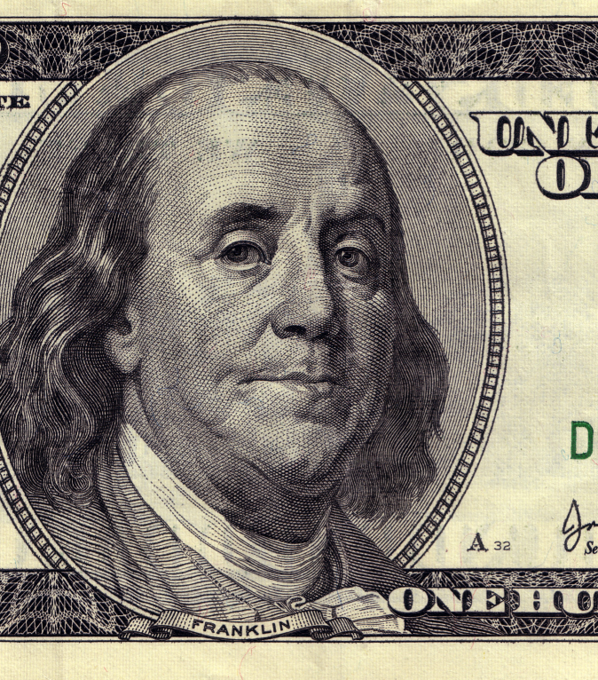
“An investment in knowledge pays the best interest.”
Benjamin Franklin

